Slide 1
PLANTAE KINGDOM
BIOLOGY CLASS XI,CHAPTER-03

Slide 2
FOUR TYPES OF CLASSIFICATION
1.ARTIFICIAL SYSTEM
2.NATURAL SYSTEM
3.PHYLOGENETIC SYSTEM
4.PHENETIC SYSTEM

Slide 3
Artificial system of classification.
The earliest systems of classification used only gross superficial morphological characters such as habit, colour, number and shape of leaves, etc.
They were based mainly on vegetative characters or on the androecium structure (system given by Linnaeus). Such systems were artificial system of classification.
They separated the closely related species since they were based on a few characteristics.
Also, the artificial systems gave equal weightage to vegetative and sexual characteristics; this is not acceptable since we know that often the vegetative characters are more easily affected byenvironment.

Slide 4
Natural classification systems
Based on natural affinities among the organisms and consider not only the external features, but also internal features, like ultrastructure, anatomy, embryology and phytochemistry.
Such a classification for flowering plants was given by George Bentham and Joseph Dalton Hooker.

Slide 5
Phylogenetic classification systems
At present phylogenetic classification systems based on evolutionary relationships between the various organisms are acceptable.
This assumes that organisms belonging to the same taxa have a common ancestor.
These become more important when there is no supporting fossil evidence.
This system are given by Engler, Hutchinson and modern by Takhtajan and Cronquist.

Slide 6
Phenetic system
Numerical Taxonomy which is now easily carried out using computers is based on all observable characteristics. Number and codes are assigned to all the characters and the data are then processed. In this way each character is given equal importance and at the same time hundreds of characters can be considered.
Cytotaxonomy that is based on cytological information like chromosome number, structure and behaviour .
Chemotaxonomy that uses the chemical constituents of the plant to resolve confusions, are also used by taxonomists these days.

Slide 7
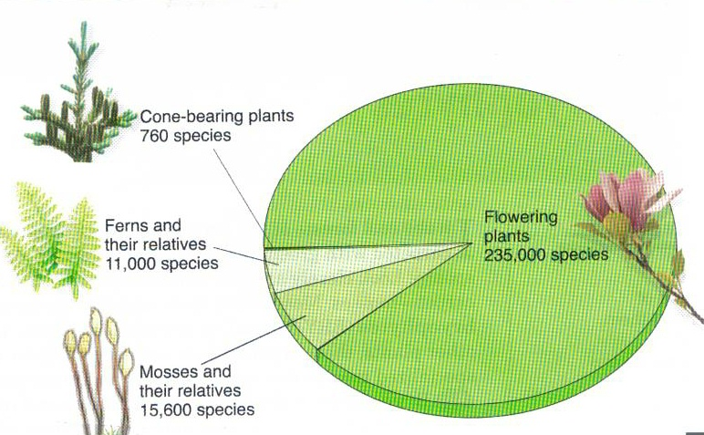
Overview of the Plant Kingdom
There are 235,000 flowering plant species, almost 90% of all living species of plants

Slide 8
PLANTAE
We will describe Plantae under
1.Algae,
2. Bryophytes,
3.Pteridophytes,
4. Gymnosperms and
5. Angiosperms.

Slide 10
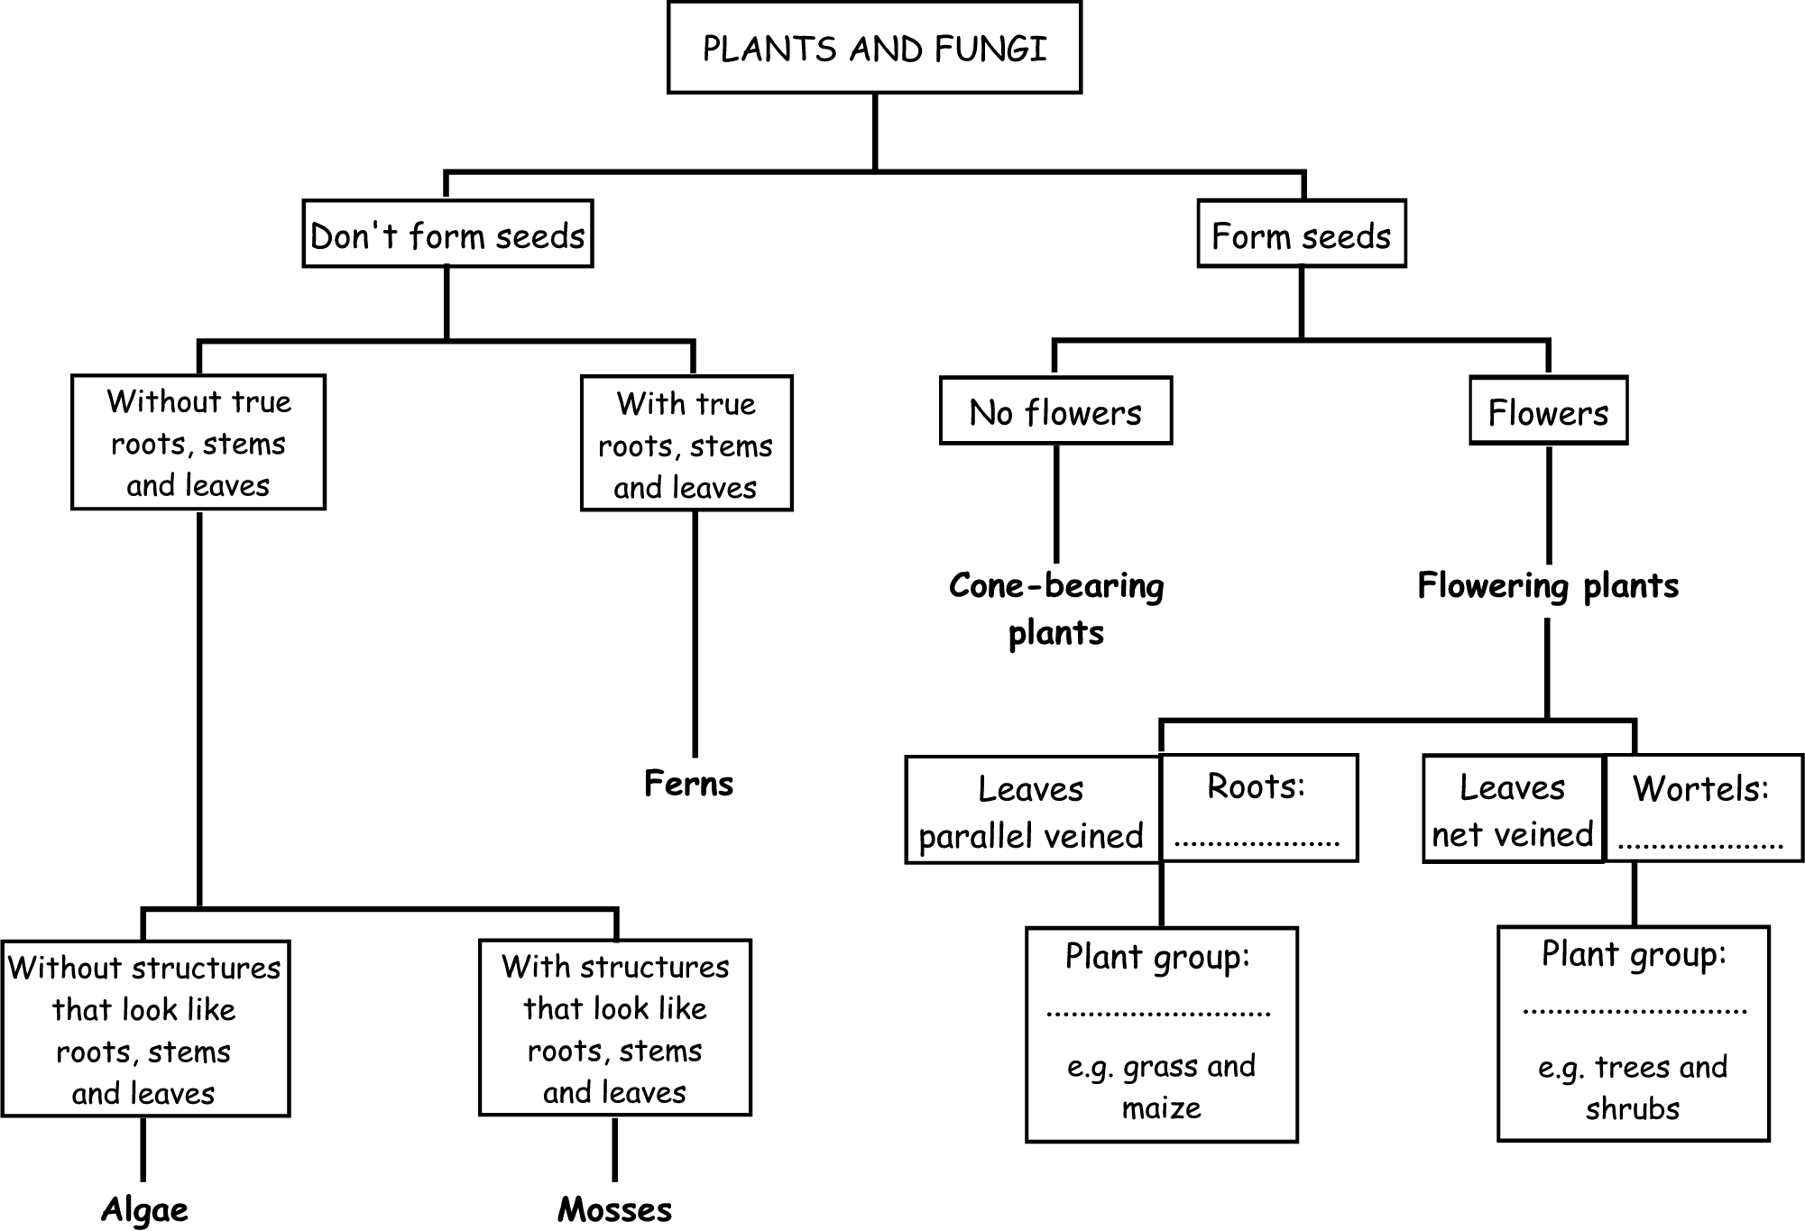

Slide 11
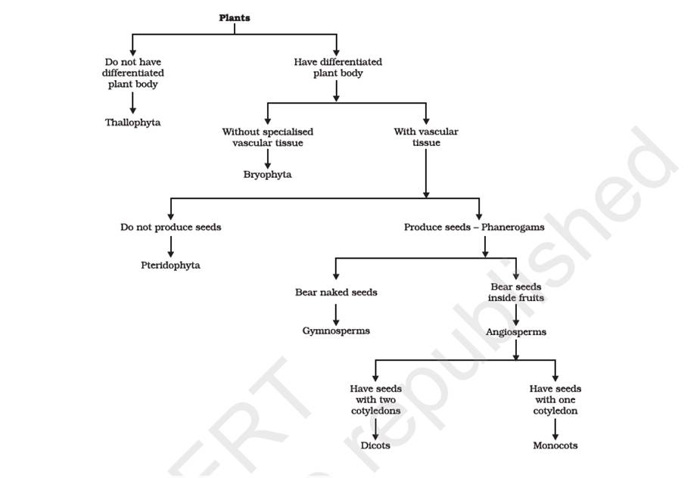

Slide 12
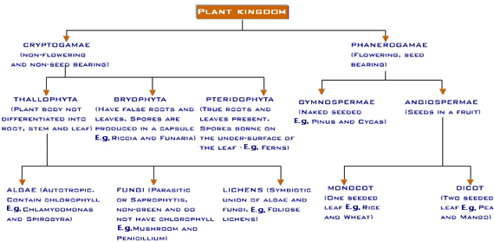

Slide 13
Cryptogams and Phanerogams
Cryptogams are flowerless or seedless plants-
1.Thallophyta (Algae),
2. Bryophytes,
3.Pteridophytes,
Phanerogams (Spermatophytes)-Flowering or seed bearing plants like-
4.Gymnosperms
5.Angiosperms

Slide 14
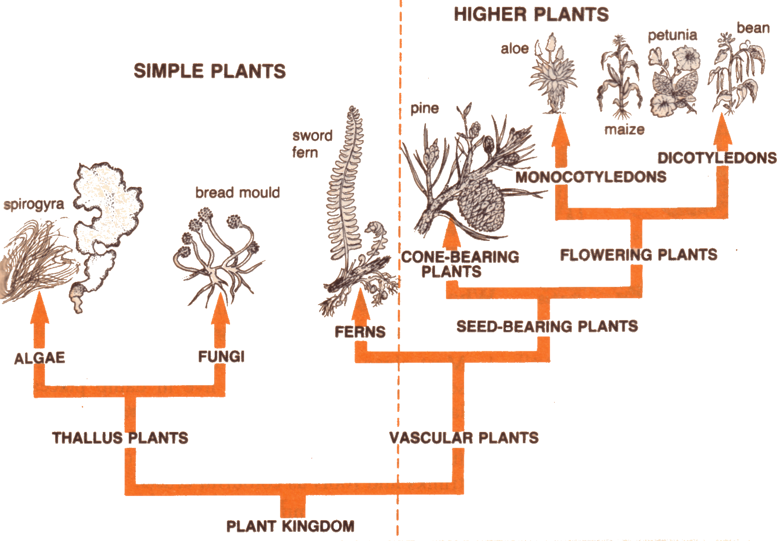

Slide 15
TRACHEOPHYTES
Vascular plants like
Pteridophytes
Gymnosperms and
Angiosperms
These are called TRACHEOPHYTES.

Slide 16
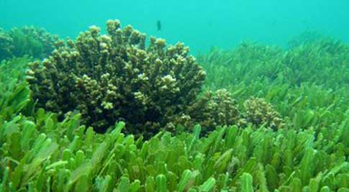
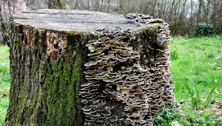
HABITAT
Algae are autotrophic, diverse group of eukaryotic organisms, ranging from unicellular to multicellular forms.
Cephaleuros is a parasite on tea plants.
Aquatic (fresh water and marine) and terrestrial environment.
They also occur in moist stones, soils, wood, on snow and on ice.
Marine Algae
Algae on wood

Slide 17
SHAPE AND SIZE OF ALGAE
Shape and size
Microscopic unicellular eg. Chlamydomonas
Colonial forms
eg. Volvox
Filamentous forms eg.Ulothrix, Spirogyra
Marine forms
eg. Kelps

Slide 18
Reproduction in Algae
Vegetative
Asexual
Sexual
Vegetative reproduction is by fragmentation.
Asexual reproduction is by the production of different types of spores, the most common being the zoospores.
Sexual reproduction takes place through fusion of two gametes. Gametes may be isogamy or anisogamy or oogamy.

Slide 19
SEXUAL REPRODUCTION
Isogamy - Fusion of two morphologically identical gametes. e.g. Spirogyra
Anisogamy - Fusion of two dissimilar gametes, i.e., one gamete is smaller than the other. e.g. some species of Chlamydomonas
Oogamy - Fusion between one large, non-motile female gamete and a smaller, motile male gamete. e.g. Volvox, Fucus

Slide 20
USEFULNESS OF ALGAE
Source of food
Used as biofertilizer
Commercial uses Agar
Sewage treatment
Alternative to chemical dyes and colouring agents

Slide 21
ECONOMIC IMPORTANCE OF ALGAE
At least a half of the total carbon dioxide fixation on earth is carried out by algae through photosynthesis.
Major component in aquatic food chain as primary producers.
Porphyra, Laminaria and Sargassum are used as food.
Algin (brown algae) and carrageen (red algae) are used as hydrocolloids, which is a fibrous structure holds water and used to transport seedling.
Agar-agar is used as commercial products cosmetics,medicines,culture media etc.
Gelidium, Gracelaria and Chondrus are used to grow microbes, make ice creams and jellies.
Chlorella and Spirullina are rich in proteins and used as food supplements.
As in agriculture.

Slide 22
gellidium
spirullina

Slide 23
Classification of Algae
Chlorophyceae (Green Algae)
Phaeophyceae (Brown Algae)
Rhodophyceae (Red Algae)

Slide 24
CHLOROPHYCEASE (GREEN ALGAE)
Unicellular / colonial / filamentous
Pigments - chlorophyll a and b
chloroplasts may be discoid, plate-like, reticulate, cup-shaped, spiral or ribbon-shaped
Store bodies – pyrenoids, oil droplets
Rigid cell wall made of an inner layer of cellulose and an outer layer of pectose

Slide 25
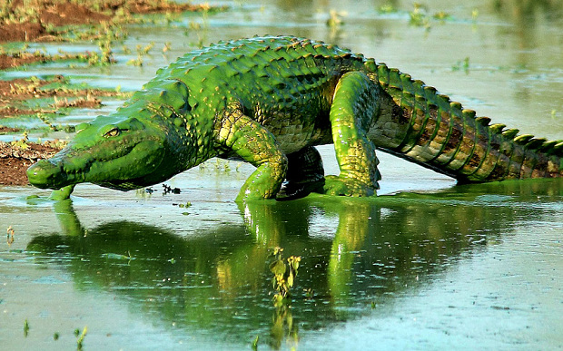

Slide 26
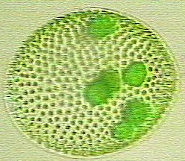
CHLOROPHYCEASE (GREEN ALGAE)
Vegetative reproduction by fragmentation
Asexual reproduction by zoospores
Volvox

Slide 27
Reproduction
Sexual reproduction by isogamous / anisogamous / oogamous
e.g. Chlamydomonas, Volvox, Ulothrix, Spirogyra and Chara

Slide 28
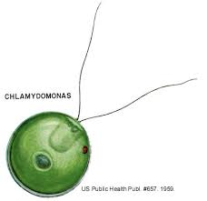
Fresh water algae
Volvox
Chlamydomonas

Slide 29
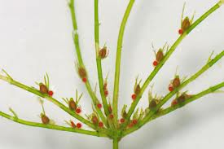
Stagnant water algae
Oedogonium
Chara

Slide 30
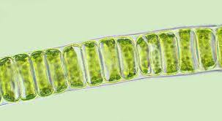
Running water algae
Cladophora
Ulothrix

Slide 31
Phaeophycease (Brown algae)
Marine habitats
Vary in shape and size from simple branched, filamentous forms (Ectocarpus) to profusely branched forms kelps about 100 m height.
Body consists of holdfast, a stalk, stipe and frond.
Pigments - chlorophyll a, c, carotenoids, xanthophylls, fucoxanthin
Food is stored as carbohydrates in the form of laminarin or mannitol.
Cell wall covered by algin, a gelatinous coating.

Slide 32
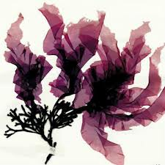
Sea water algae
Ectocarpus
Porphyra

Slide 33
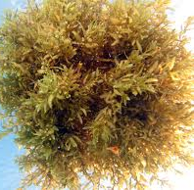
Vegetative reproduction by fragmentation.
Asexual reproduction by biflagellate zoospores.
Sexual reproduction may be isogamous, anisogamous or oogamous
e.g. Ectocarpus, Dictyota, Laminaria, Sargassum and Fucus
Sargassum

Slide 34
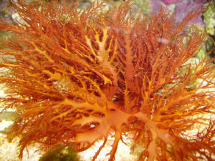
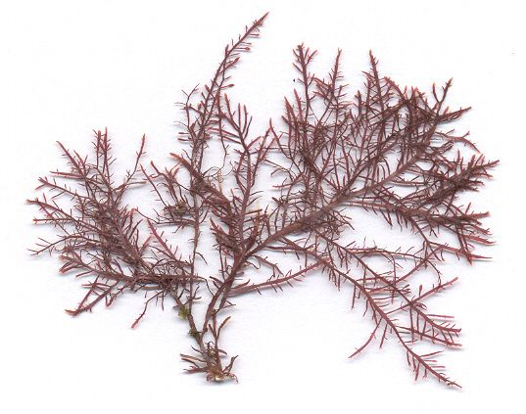
Rhodophycease ( Red algae)
Habitat – some fresh water, brackish water, mostly in salt water
Pigments - chlorophyll a and d,
r-phycoerythrin
Food is stored as Floridean starch, which is similar to amylopectin and glycogen in structure.
Vegetative reproduction is by fragmentation
Asexually by non-motile spores
Sexually by non-motile gametes
e.g. Polysiphonia, Porphyra, Gracilaria, Gelidium
Gracilaria
Gelidium

Slide 35
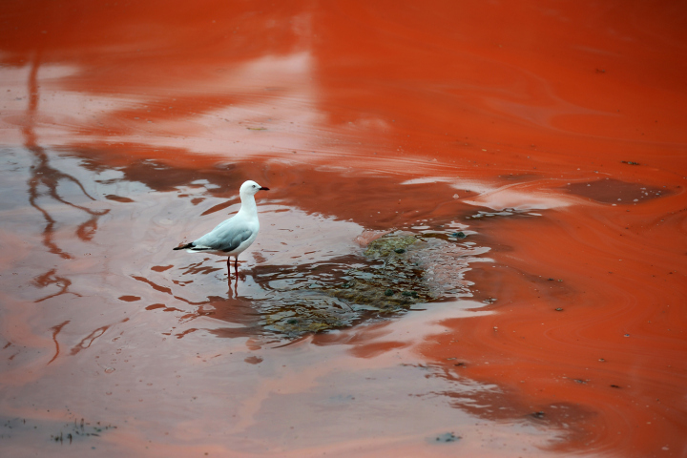

Slide 36
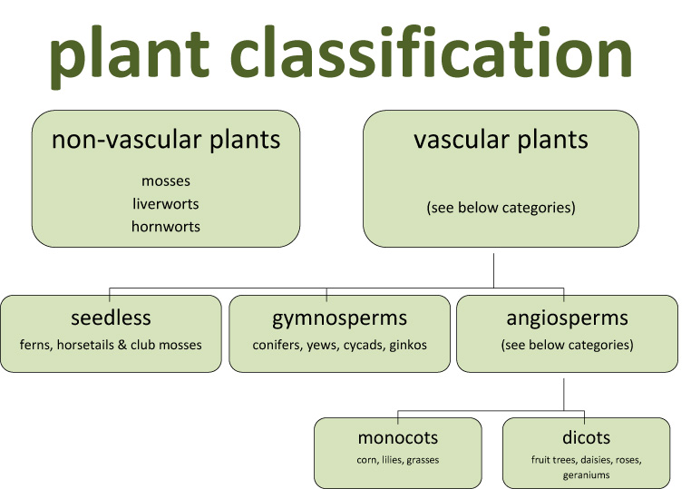

Slide 37
Bryophytes
Brown (1864)-coined the term Bryophytes .
Bawsonia(40-50cm in length)is the largest bryophytes.
Zoopsis is the smallest known bryophytes.
Genus Riccia was named after P.F.Ricci,a physician.
Genus Marchantia was named after N. Marchant,Director of a botanical garden in France.
Prof.Shiv Ram Kashyap is known as Father of Indian Bryology.

Slide 38
BRYOPHYTES
Bryophytes are also called amphibians of the plant kingdom because these plants can live in soil but are dependent on water for sexual reproduction.
They usually occur in damp, humid and shaded localities.
They play an important role in plant succession on bare rocks/soil.

Slide 39
Structure of Bryophytes
The plant body of bryophytes is more differentiated than that of algae.
It is thallus-like and prostrate or erect, and attached to the substratum by unicellular or multicellular rhizoids.
They lack true roots, stem or leaves.
They may possess root-like, leaf-like or stem-like structures.
The main plant body of the bryophyte is haploid.
It produces gametes, hence is called a gametophyte. The sex organs in bryophytes are multicellular.

Slide 40
Reproduction
The male sex organ is called antheridium.
They produce biflagellate antherozoids.
The female sex organ called archegonium is flask-shaped and produces a single egg.
The antherozoids are released into water where they come in contact with archegonium.
An antherozoid fuses with the egg to produce the zygote.
Zygotes do not undergo reduction division immediately.
They produce a multicellular body called a sporophyte.
The sporophyte is not free-living but attached to the photosynthetic gametophyte and derives nourishment from it.

Slide 41
Cont.
The sporophyte is not free-living but attached to the photosynthetic gametophyte and derives nourishment from it.
Some cells of the sporophyte undergo reduction division (meiosis) to produce haploid spores.
These spores germinate to produce gametophyte.

Slide 42
ECONOMIC IMPORTANCE
Bryophytes in general are of little economic importance but some mosses provide food for herbaceous mammals, birds and other animals.
Species of Sphagnum, a moss, provide peat that have long been used as fuel, and as packing material for trans-shipment of living material because of their capacity to hold water.
Mosses along with lichens are the first organisms to colonise rocks and hence, are of great ecological importance.
They decompose rocks making the substrate suitable for the growth of higher plants. Since mosses form dense mats on the soil, they reduce the impact of falling rain and prevent soil erosion.

Slide 43
CLASSIFICATION
The bryophytes are divided into liverworts and mosses.
1. The liverworts grow usually in moist, shady habitats such as banks of streams, marshy ground, damp soil, bark of trees and deep in the woods.
The plant body of a liverwort is thalloid, e.g., Marchantia.
The thallus is dorsiventral and closely appressed to the substrate.
The leafy members have tiny leaf-like appendages in two rows on the stem-like structures.

Slide 44
LIVERWORTS
Asexual reproduction in liverworts takes place by fragmentation of thalli, or by the formation of specialised structures called gemmae (sing. gemma).
Gemmae are green, multicellular, asexual buds, which develop in small receptacles called gemma cups located on the thalli.
The gemmae become detached from the parent body and germinate to form new individuals.

Slide 45
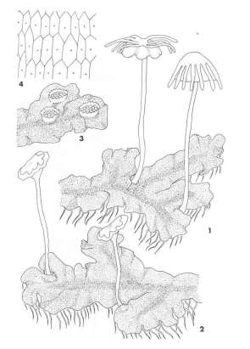

Slide 46
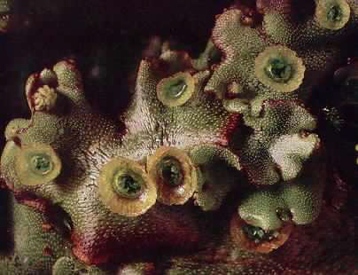
GEMMAE CUP

Slide 47
CON…
During sexual reproduction, male and female sex organs are produced either on the same or on different thalli.
The sporophyte is differentiated into a foot, seta and capsule.
After meiosis, spores are produced within the capsule.
These spores germinate to form free-living gametophytes.

Slide 48
MOSSES
The predominant stage of the life cycle of a moss is the gametophyte which consists of two stages.
The first stage is the protonema stage, which develops directly from a spore.
It is a creeping, green, branched and frequently filamentous stage.
The second stage is the leafy stage, which develops from the secondary protonema as a lateral bud.
They consist of upright, slender axes bearing spirally arranged leaves.
They are attached to the soil through multicellular and branched rhizoids. This stage bears the sex organs.

Slide 49
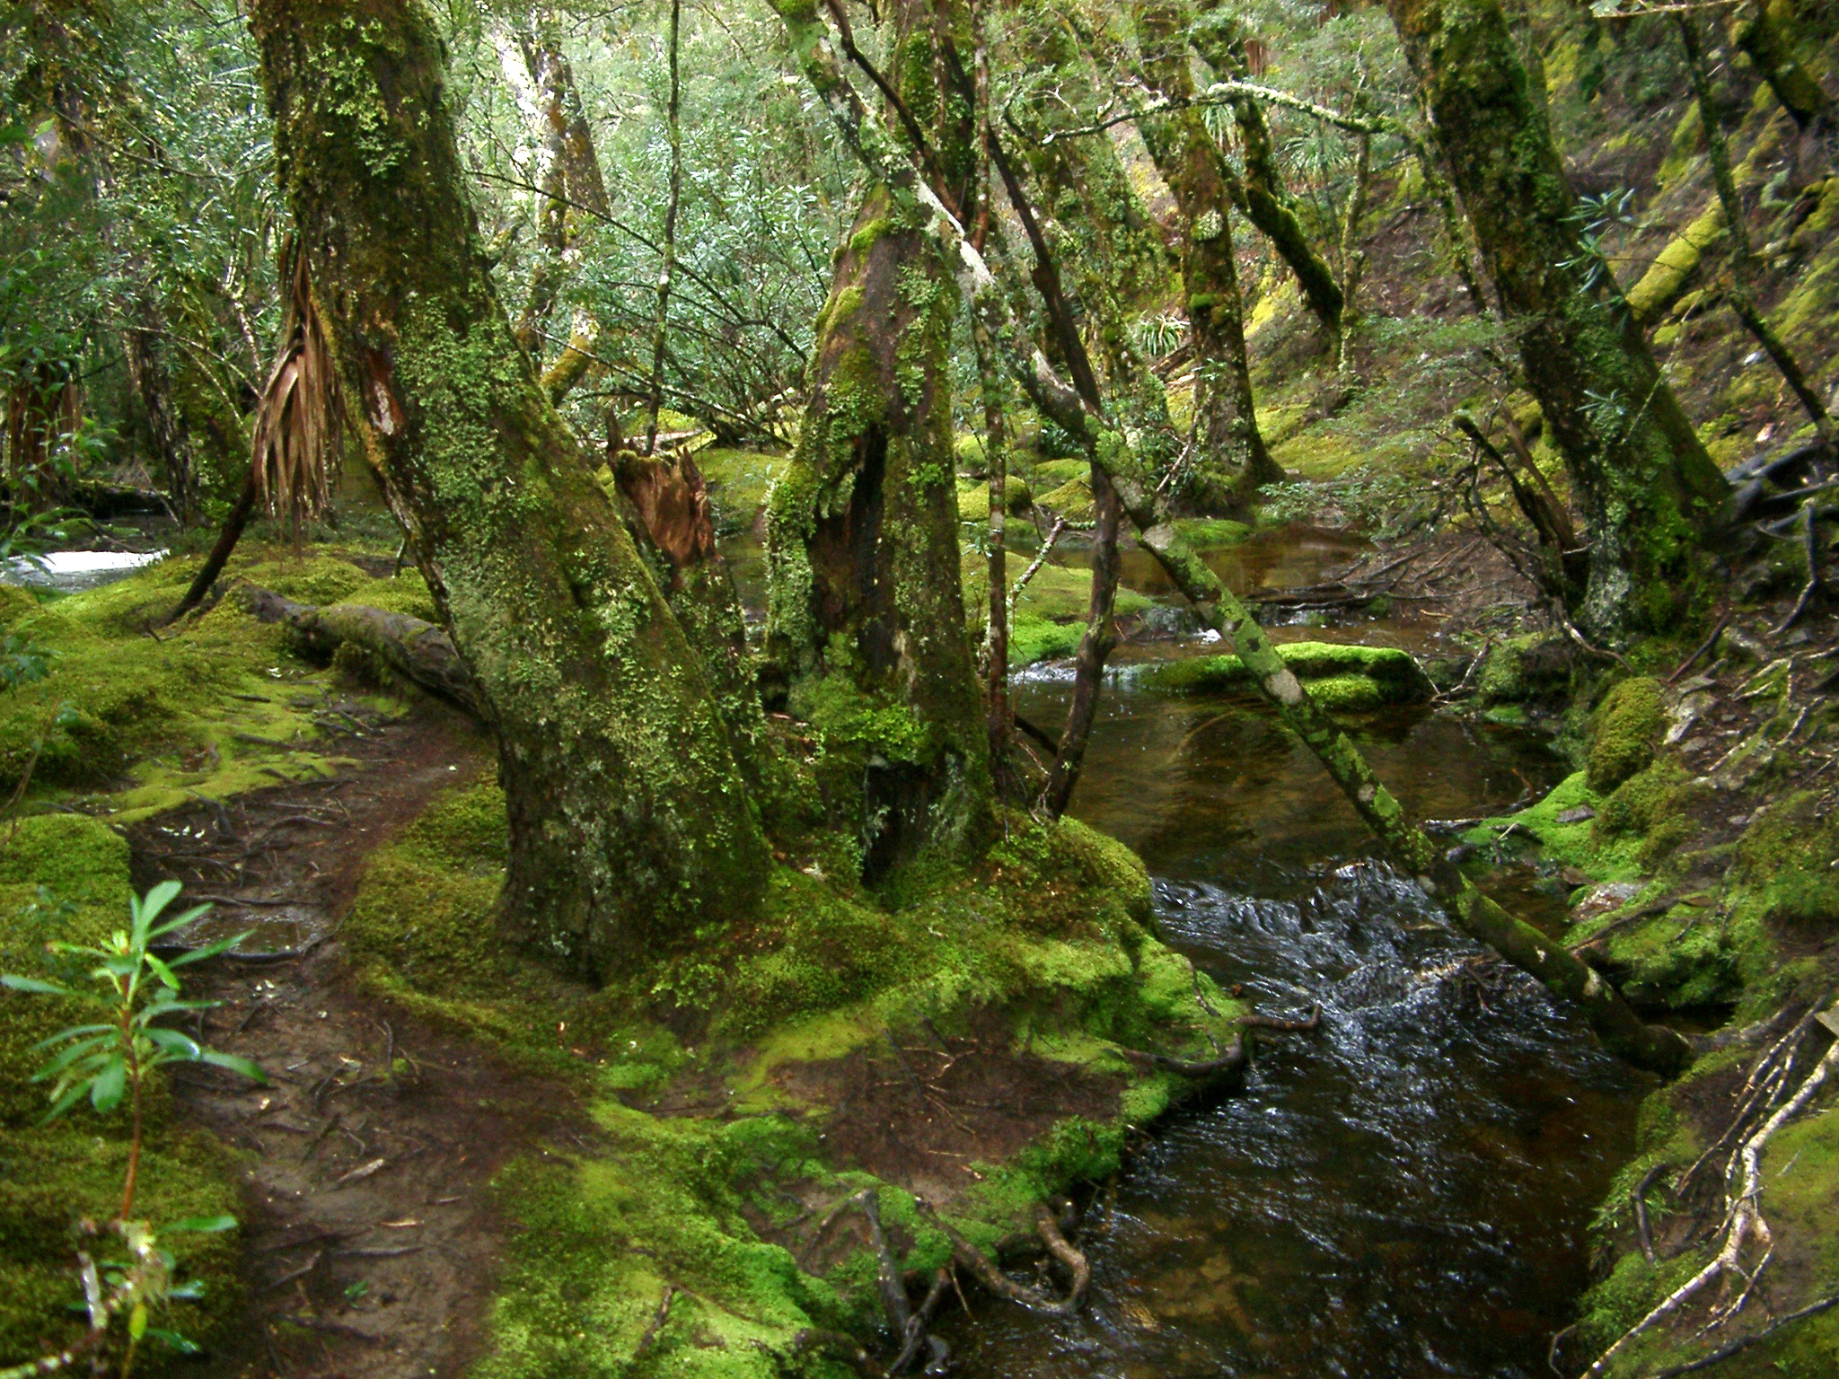
1. mosses
Largest group of nonvascular plants
Reproduce by spores

Slide 50
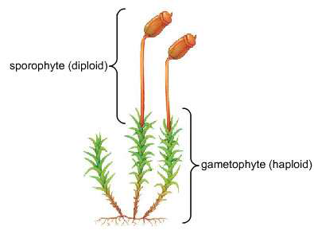

Slide 51
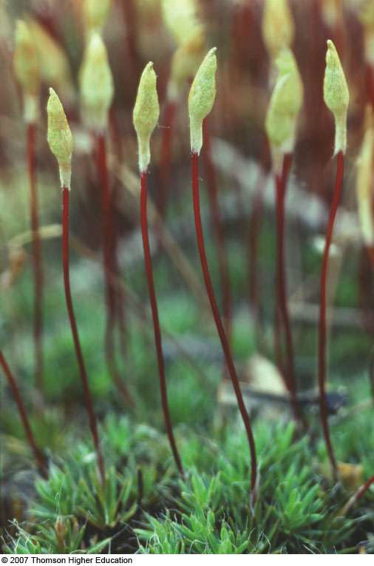
CAPSULE
SETA
FOOT

Slide 52
REPRODUCTION
Vegetative reproduction in mosses is by fragmentation and budding in the secondary protonema.
In sexual reproduction, the sex organs antheridia and archegonia are produced at the apex of the leafy shoots.
After fertilisation, the zygote develops into a sporophyte, consisting of a foot, seta and capsule.
The sporophyte in mosses is more elaborate than that in liverworts.
The capsule contains spores.
Spores are formed after meiosis. The mosses have an elaborate mechanism of spore dispersal.
Common examples of mosses are Funaria, Polytrichum and Sphagnum (Figure 3.2).

Slide 53
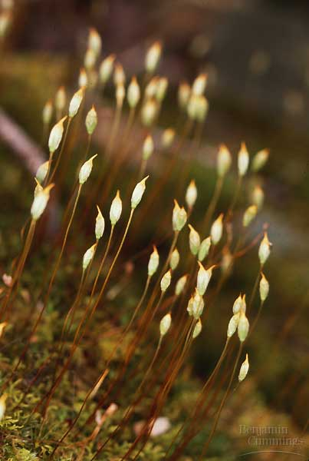
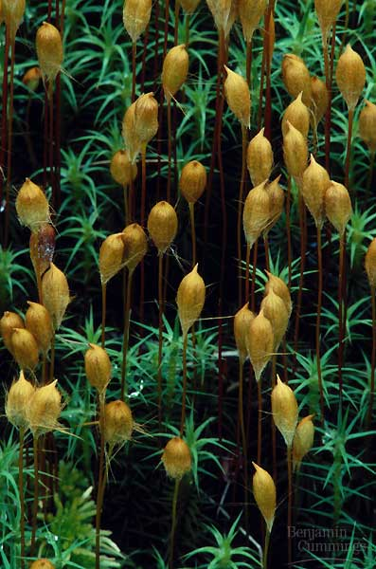
Moss sporophytes

Slide 54
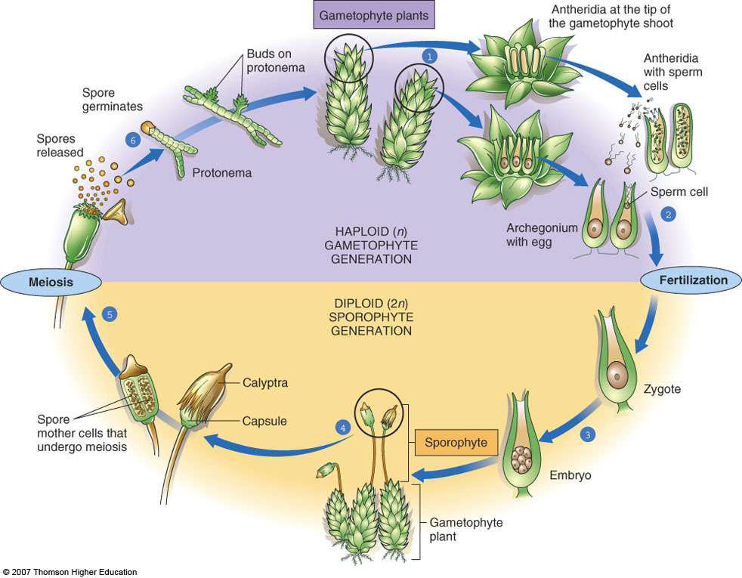

Slide 55
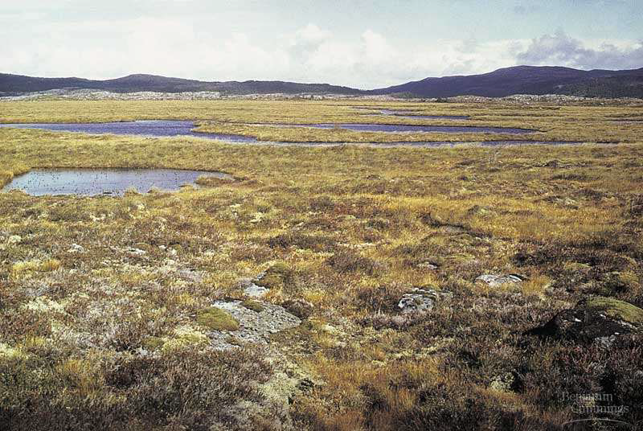
SPHAGNUM,PEAT MOSS

Slide 56
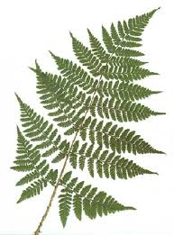

Slide 57
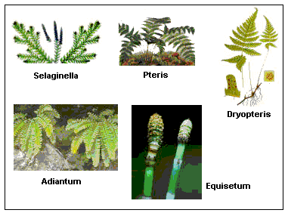

Slide 58
PTERIDOPHYTES (Pteron=feather+phyton=plants)
They are the first terrestrial plants to possess vascular tissues – xylem and phloem.
Companion cells,Vessels and secondary growth absent
The pteridophytes are found in cool, damp, shady places though some may flourish well in sandy-soil conditions.
In bryophytes the dominant phase in the life cycle is the gametophytic plant body.
However, in pteridophytes, the main plant body is a sporophyte which is differentiated into true root, stem and leaves (Figure 3.3).

Slide 59
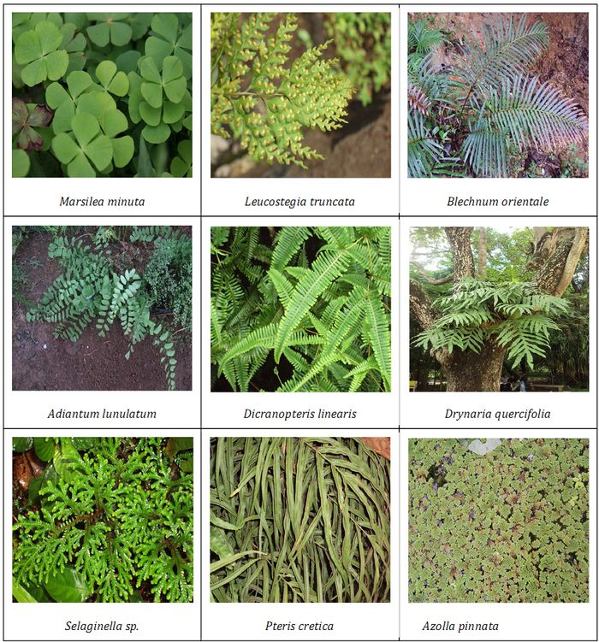

Slide 60
STRUCTURE OF PTERIDOPHYTES
These organs possess well-differentiated vascular tissues.
The leaves in pteridophyta are small (microphylls) as in Selaginella or large (macrophylls) as in ferns.
Adiantum ``maiden hair fern``.
The sporophytes bear sporangia that are subtended by leaf-like appendages called sporophylls.
In some cases sporophylls may form distinct compact structures called strobili or cones (Selaginella, Equisetum).
The sporangia produce spores by meiosis in spore mother cells.
The spores germinate to give rise to inconspicuous, small but multicellular, free-living, mostly photosynthetic thalloid gametophytes called prothallus.

Slide 61
CONT.
These gametophytes require cool, damp, shady places to grow. Because of this specific restricted requirement and the need for water for fertilization, the spread of living pteridophytes is limited and restricted to narrow geographical regions.
The gametophytes bear male and female sex organs called antheridia and archegonia, respectively.
Water is required for transfer of antherozoids – the male gametes released from the antheridia, to the mouth of archegonium.
Seed habit first originated in ferns(pteridophyta).

Slide 62
rEPRODUCTION
Fusion of male gamete with the egg present in the archegonium result in the formation of zygote.
Zygote thereafter produces a multicellular well-differentiated sporophyte which is the dominant phase of the pteridophytes.
In majority of the pteridophytes all the spores are of similar kinds; such plants are called homosporous.
Genera like Selaginella and Salvinia which produce two kinds of spores, macro (large) and micro (small) spores, are known as heterosporous.

Slide 63
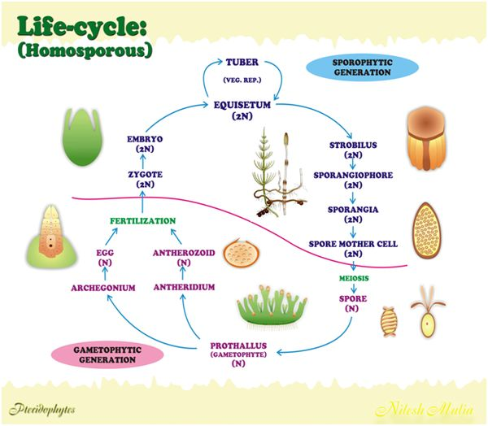

Slide 64
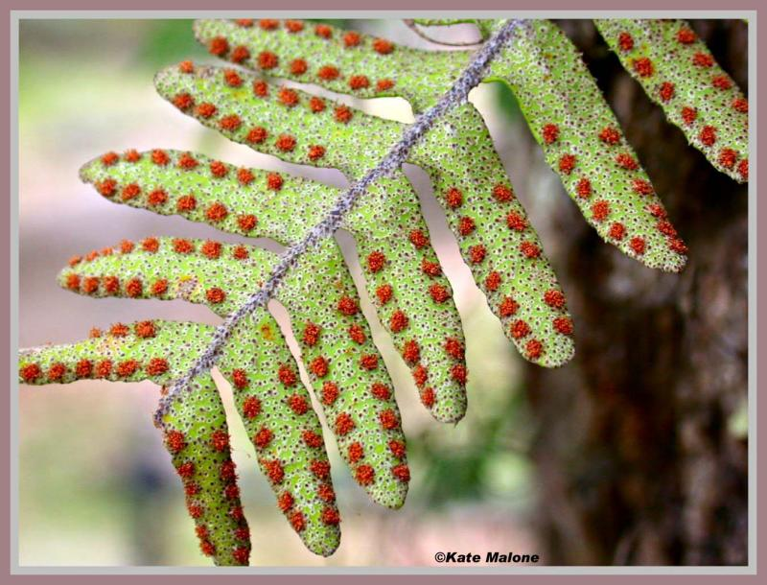

Slide 65
REPRODUCTION
The megaspores and microspores germinate and give rise to female and male gametophytes, respectively.
The female gametophytes in these plants are retained on the parent sporophytes for variable periods.
The development of the zygotes into young embryos take place within the female gametophytes.
This event is a precursor to the seed habit considered an important step in evolution.

Slide 66
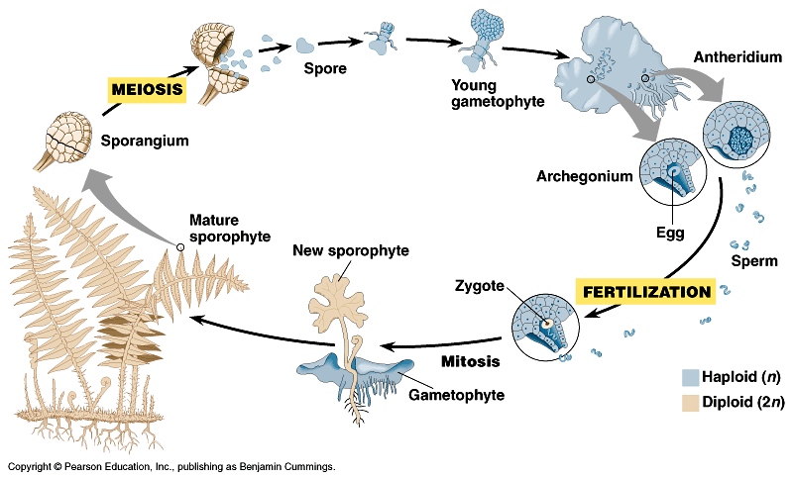
Alternation of generations

Slide 67
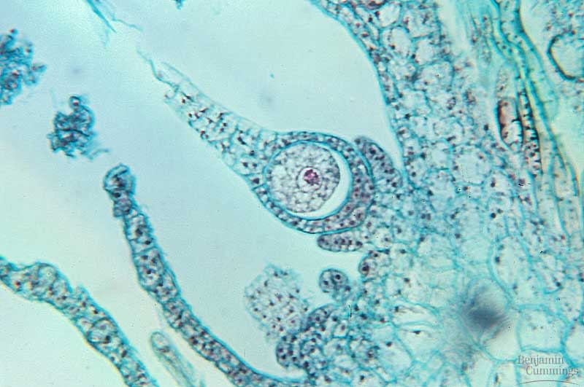
Alternation of generations
Archegonium
female gamete-producing structure
produces a single egg cell in a vase-shaped organ

Slide 68
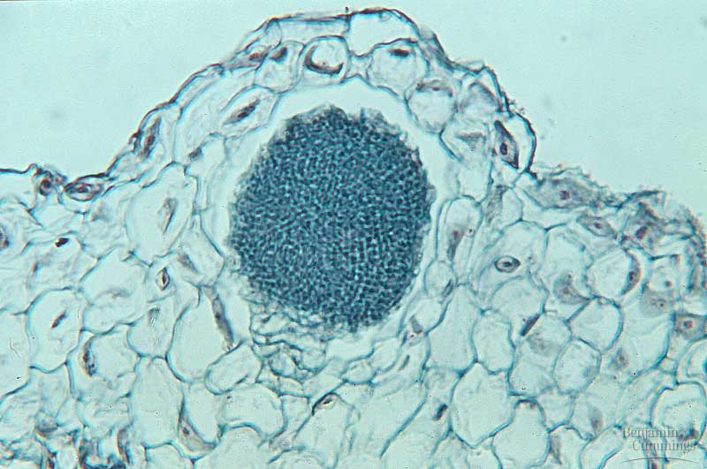
Alternation of generations
Antheridia
male gamete-producing structure
produces many sperm cells that are released to the environment
flagella =
swimming sperm

Slide 69
CLASSIFICATION
The pteridophytes are further classified into four classes:
Psilopsida(Psilotum);
Lycopsida (Selaginella, Lycopodium),
Sphenopsida (Equisetum)and
Pteropsida (Dryopteris, Pteris, Adiantum).

Slide 70
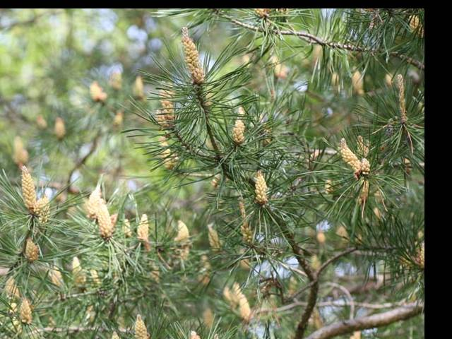
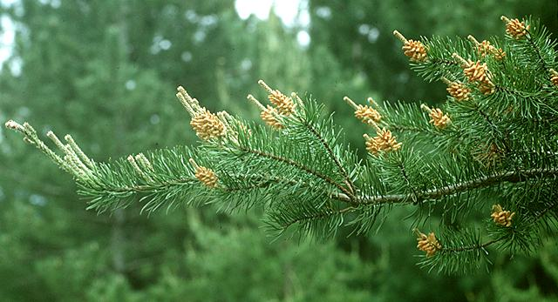
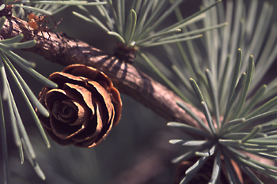
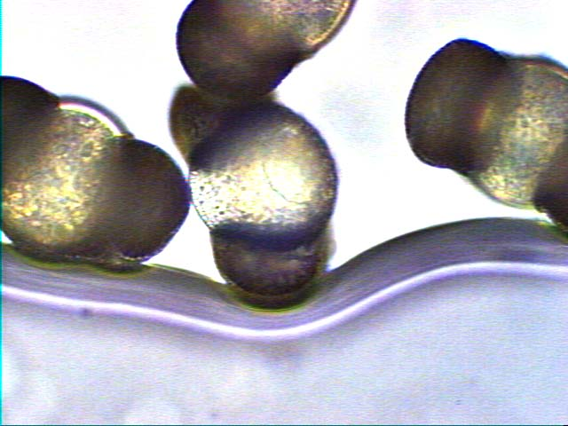
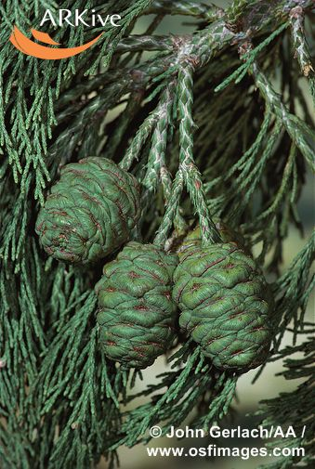
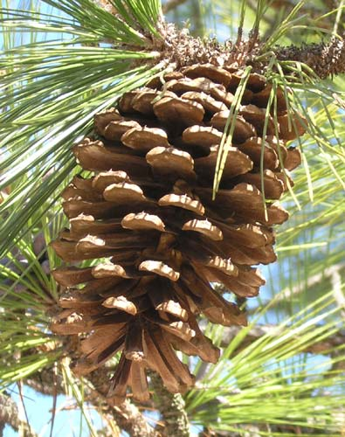
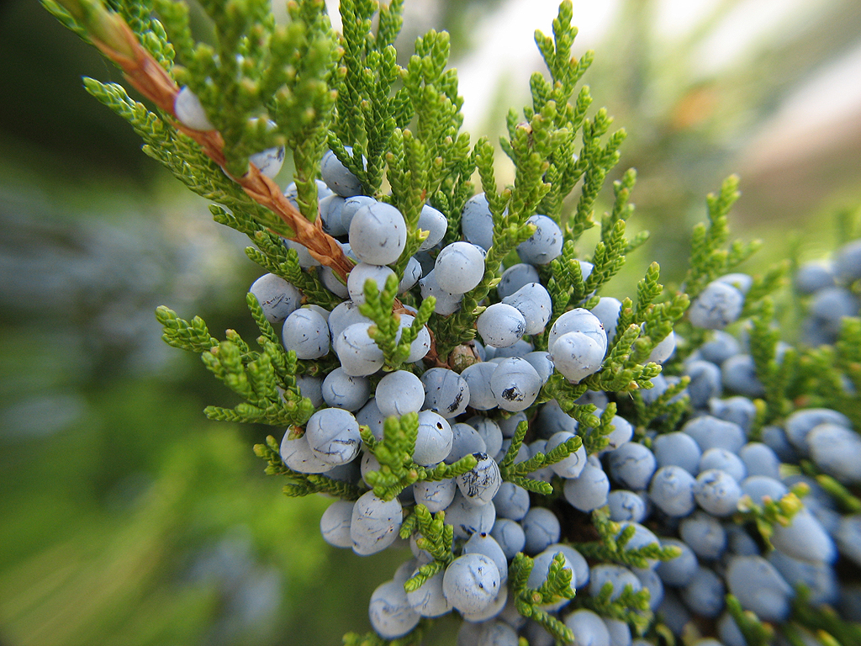
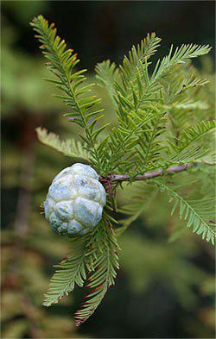
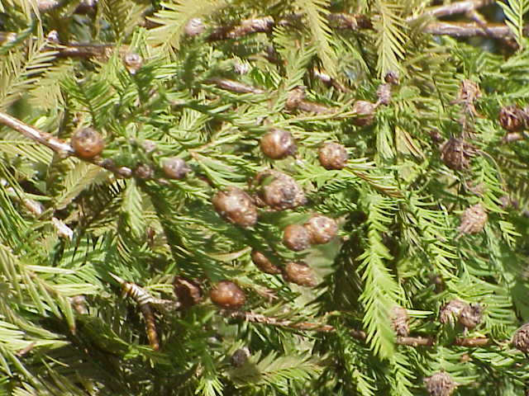
Gymnosperms
NAKED SEED

Slide 71
Gymnosperms
The gymnosperms (gymnos : naked, sperma : seeds) are plants in which the ovules are not enclosed by any ovary wall and remain exposed, both before and after fertilisation.
Theophrastus first time used the term.
The seeds that develop post-fertilisation, are not covered, i.e., are naked.
Gymnosperms include medium-sized trees or tall trees and shrubs (Figure 3.4).
One of the gymnosperms, the giant redwood tree Sequoia(112 Feet) is one of the tallest tree species.
The roots are generally tap roots.

Slide 72
GYMNOSPERM
Roots in some genera have fungal association in the form of mycorrhiza (Pinus), while in some others (Cycas) small specialised roots called coralloid roots are associated with N2- fixing cyanobacteria.
The stems are unbranched (Cycas) or branched (Pinus, Cedrus). The leaves may be simple or compound.
Don’t have vessels except Ephedra,Gnetum and Welwitchia and companion cells in phloem.
In Cycas the pinnate leaves persist for a few years.
The leaves in gymnosperms are well-adapted to withstand extremes of temperature, humidity and wind.
In conifers, the needle-like leaves reduce the surface area.
Their thick cuticle and sunken stomata also help to reduce water loss.
Ephedra has double fertilization produce Ephedrine which is used against Asthama(seed oil).
Endosperm is haploid and develop before fertilization.

Slide 73
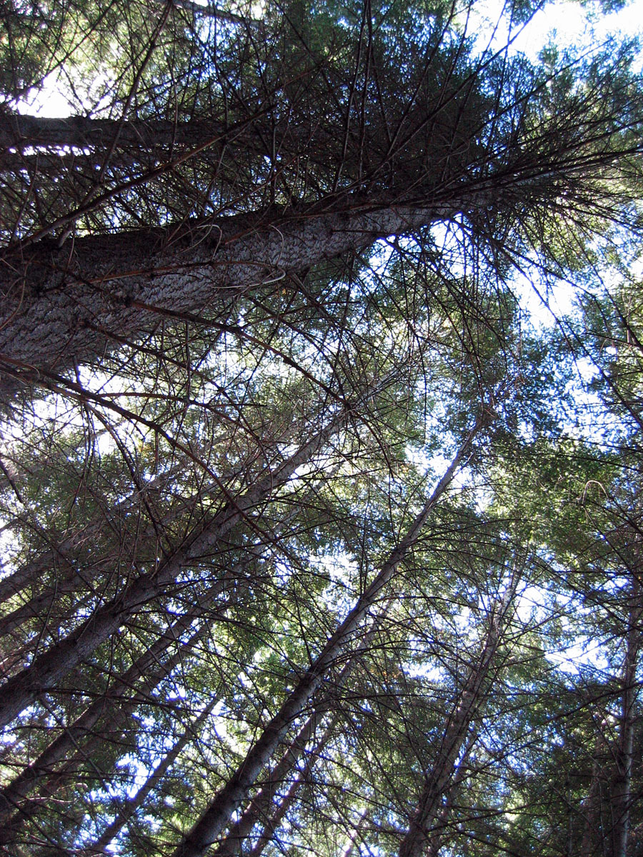

Slide 74
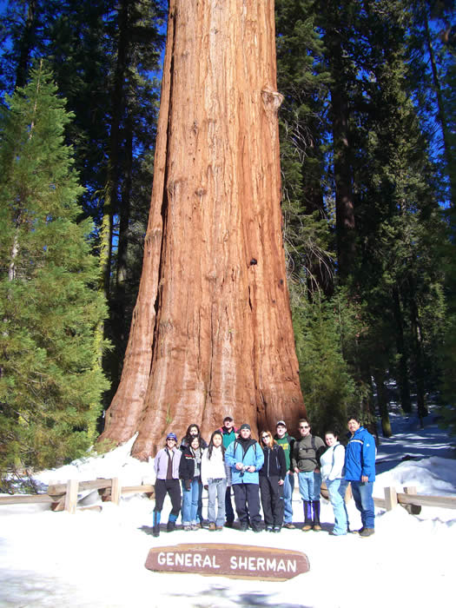
Sequoiadendron

Slide 75
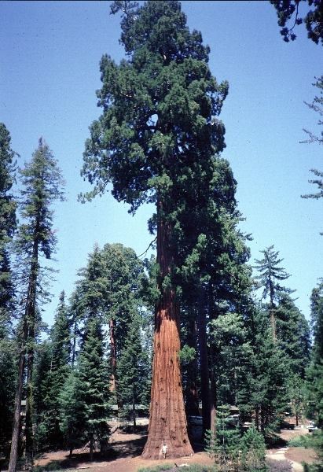
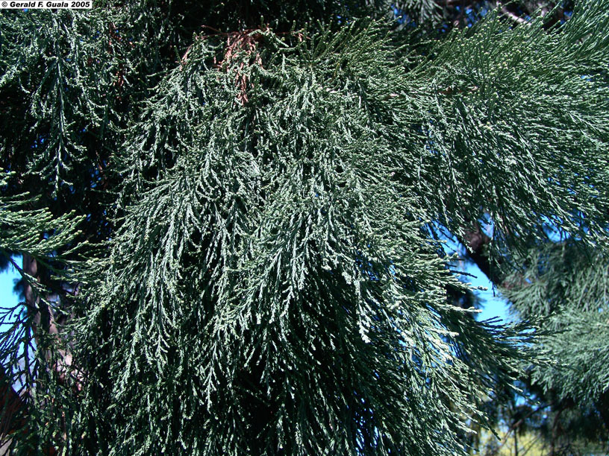
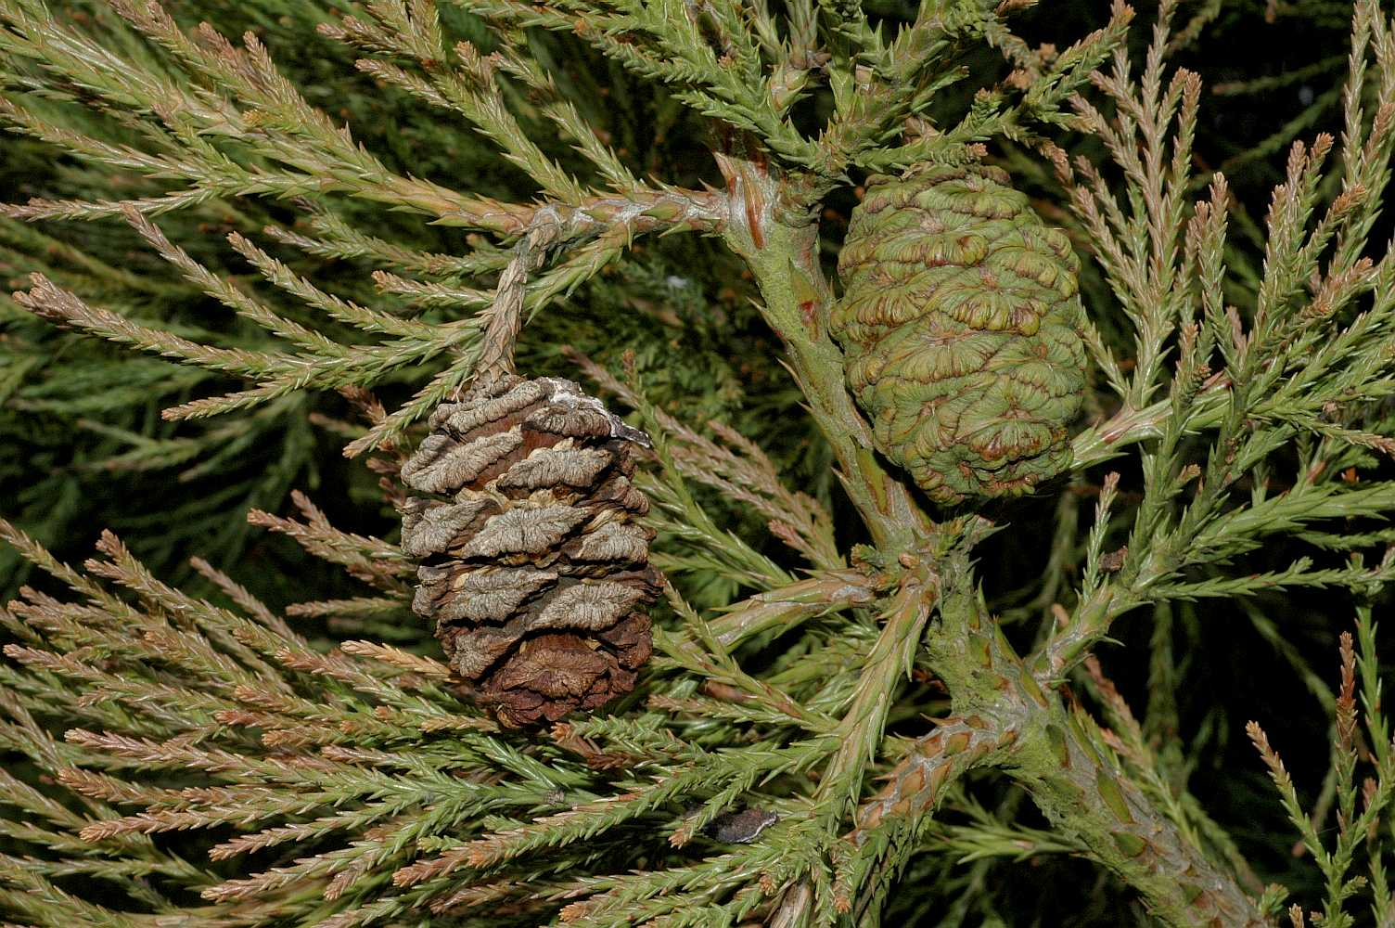

Slide 76
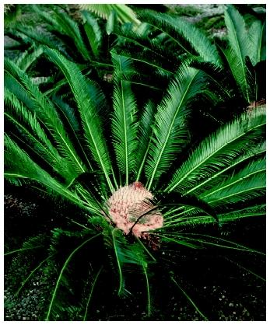
Gymnosperms
Cycads: look like ferns except they have seeds
Ginkgo: very large trees found mainly in China

Slide 77
REPRODUCTION
The gymnosperms are heterosporous; they produce haploid microspores and megaspores.
The two kinds of spores are produced within sporangia that are borne on sporophylls which are arranged spirally along an axis to form lax or compact strobili or cones.
The strobili bearing microsporophylls and microsporangia are called microsporangiate or male strobili.
The microspores develop into a male gametophytic generation which is highly reduced and is confined to only a limited number of cells.
This reduced gametophyte is called a pollen grain.
The development of pollen grains take place within the microsporangia.

Slide 78
Gymnosperm life cycle
female gametophyte in cone
male gametophyte in pollen
sporophyte in seed

Slide 79
Ovulating pine cones

Slide 80
REPRODUCTION IN GYMNOSPERM
The cones bearing megasporophylls with ovules or megasporangia are called macrosporangiate or female strobili.
The male or female cones or strobili may be borne on the same tree (Pinus).
However, in cycas male cones and megasporophylls are borne on different trees.
The megaspore mother cell is differentiated from one of the cells of the nucellus.
The nucellus is protected by envelopes and the composite structure is called an ovule.
The ovules are borne on megasporophylls which may be clustered to form the female cones.

Slide 81
REPRODUCTION
The megaspore mother cell divides meiotically to form four megaspores.
One of the megaspores enclosed within the megasporangium (nucellus) develops into a multicellular female gametophyte that bears two or more archegonia or female sex organs.
The multicellular female gametophyte is also retained within megasporangium.

Slide 83
REPRODUCTION
Unlike bryophytes and pteridophytes, in gymnosperms the male and the female gametophytes do not have an independent free-living existence.
They remain within the sporangia retained on the sporophytes.
The pollen grain is released from the microsporangium.
They are carried in air currents and come in contact with the opening of the ovules borne on megasporophylls.
The pollen tube carrying the male gametes grows towards archegonia in the ovules and discharge their contents near the mouth of the archegonia.
Following fertilisation, zygote develops into an embryo and the ovules into seeds.
These seeds are not covered.

Slide 84
Gymnosperm life cycle
Exhibits alternation of generations
Sporophyte generation (2n) is dominant
Gametophyte generation (1n) is contained in and dependent on the sporophyte generation

Slide 85
Other gymnosperms
Cycads – short shrubs, native to tropical regions (look like palms),
largest ovule and sperms.
Ginkgo biloba – a “living fossil”, male and female tree, used as a medicinal plant

Slide 86
Seeds
Seeds: the fertilized egg
Seed Structure: consists of a seed coat, a young plant, and stored food

Slide 87
Ginkophyta
Ginko biloba

Slide 88
Cycadophyta

Slide 89
Significance of gymnosperms
Ecological importance:
Provide food and habitat for wildlife
Forests prevent soil erosion
Reduce greenhouse-effect gasses
Economic and commercial importance:
Lumber for wood, paper, etc.
Resins – wood, furniture, etc.
Ornamental plants (trees, landscaping)
Food – pine nuts (pesto, etc.)

Slide 90
ANGIOSPERMS
Angiosperm means “covered seed”
Have flowers
Have fruits with seeds
Live everywhere – dominant plants in the world
260,000 species (88% of Plant Kingdom)
Angiosperms are the most successful and advanced plants on earth

Slide 91
Angiosperms
In the angiosperms or flowering plants, the pollen grains and ovules are developed in specialised structures called flowers.
In angiosperms, the seeds are enclosed by fruits.
The angiosperms are an exceptionally large group of plants occurring in wide range of habitats.
They range in size from tiny, almost microscopic Wolfia to tall trees of Eucalyptus (over 100 metres).
They provide us with food, fodder, fuel, medicines and several other commercially important products. They are divided into two classes : the dicotyledons and the monocotyledons (Figure 3.5).

Slide 92
pistil

Slide 93
Parts of flower
Male
stamens = male reproductive organs
stamens have stalks (filament) & terminal anthers which carry pollen sacs
pollen sacs produce pollen
pollen grain = gametophyte
sperm-producing structure

Slide 94
Male Parts
The stamens are the male structures of the flower.
Made up of two parts:
Anther
Filament

Slide 97
Male Parts
Anther: top part of the stamen, that makes pollen.
Filament: this is the stalk of the Anther

Slide 98
Parts of flower
Female
carpels = female reproductive organs
ovary at the base
slender neck = style
within the ovary are 1 or more ovules
within ovules are embryo sacs
female gametophyte = embryo sac
egg-producing structure

Slide 99
Female Parts
Pistil is the female structure of flower that has 3 parts:
Stigma
Style
Ovary

Slide 100
Female Parts
stigma
Stigma:
The pollen from another flower collects on the stigma’s sticky surface.
Style:
raises the stigma away from the Ovary

Slide 101
Female Parts
Ovary protects the ovules(egg).
Once fertilization has taken place it will become the fruit.

Slide 102
REPRODUCTION
The dicotyledons are characterised by having two cotyledons in their seeds while the monocolyledons have only one.
The male sex organ in a flower is the stamen. Each stamen consists of a slender filament with an anther at the tip.
The anthers, following meiosis, produce pollen grains.
The female sex organ in a flower is the pistil or the carpel.
Pistil consists of an ovary enclosing one to many ovules.
Within ovules are present highly reduced female gametophytes termed embryo sacs.

Slide 103
REPRODUCTION
The embryo-sac formation is preceded by meiosis.
Hence, each of the cells of an embryo-sac is haploid.
Each embryo-sac has a three-celled egg apparatus – one egg cell and two synergids, three antipodal cells and two polar nuclei.
The polar nuclei eventually fuse to produce a diploid secondary nucleus.
Pollen grain, after dispersal from the anthers, are carried by wind or various other agencies to the stigma of a pistil. This is termed as pollination

Slide 104
REPRODUCTION
. The pollen grains germinate on the stigma and the resulting pollen tubes grow through the tissues of stigma and style and reach the ovule.
The pollen tubes enter the embryo-sac where two male gametes are discharged.
One of the male gametes fuses with the egg cell to form a zygote (syngamy).
The other male gamete fuses with the diploid secondary nucleus to produce the triploid primary endosperm nucleus (PEN).
Because of the involvement of two fusions, this event is termed as double fertilisation, an event unique to angiosperms.

Slide 105
Fertilization in flowering plants
Double fertilization
2 sperm from pollen
1 sperm fertilizes egg = diploid zygote
1 sperm fuses with 2 polar nuclei to form 3n endosperm
endosperm = food tissue in seed
coconut milk
grains

Slide 106
EMBRYO SAC
The zygote develops into an embryo (with one or two cotyledons) and the PEN develops into endosperm which provides nourishment to the developing embryo.
The synergids and antipodals degenerate after fertilisation.
During these events the ovules develop into seeds and the ovaries develop into fruit.
The life cycle of an angiosperm is shown in Figure 3.6

Slide 109
Fertilization
Pollination
pollen released from anthers is carried by wind or animals to land on stigma
pollen grain produces a pollen tube
pollen tube grows down style into ovary & discharges 2 sperm into the embryo sac
1 sperm fertilizes egg = zygote
zygote develops into embryo
ovule develops into a seed
ovary develops into a fruit containing 1 or more seeds

Slide 110
Fruit
Fruit is a mature ovary
seeds develop from ovules
wall of ovary thickens to form fruit
fruits protect dormant seeds & aid in their dispersal

Slide 111
Characteristics of Monocots & Dicots

Slide 112
Any Questions??

Slide 113
Thank u…..

